Slide 1
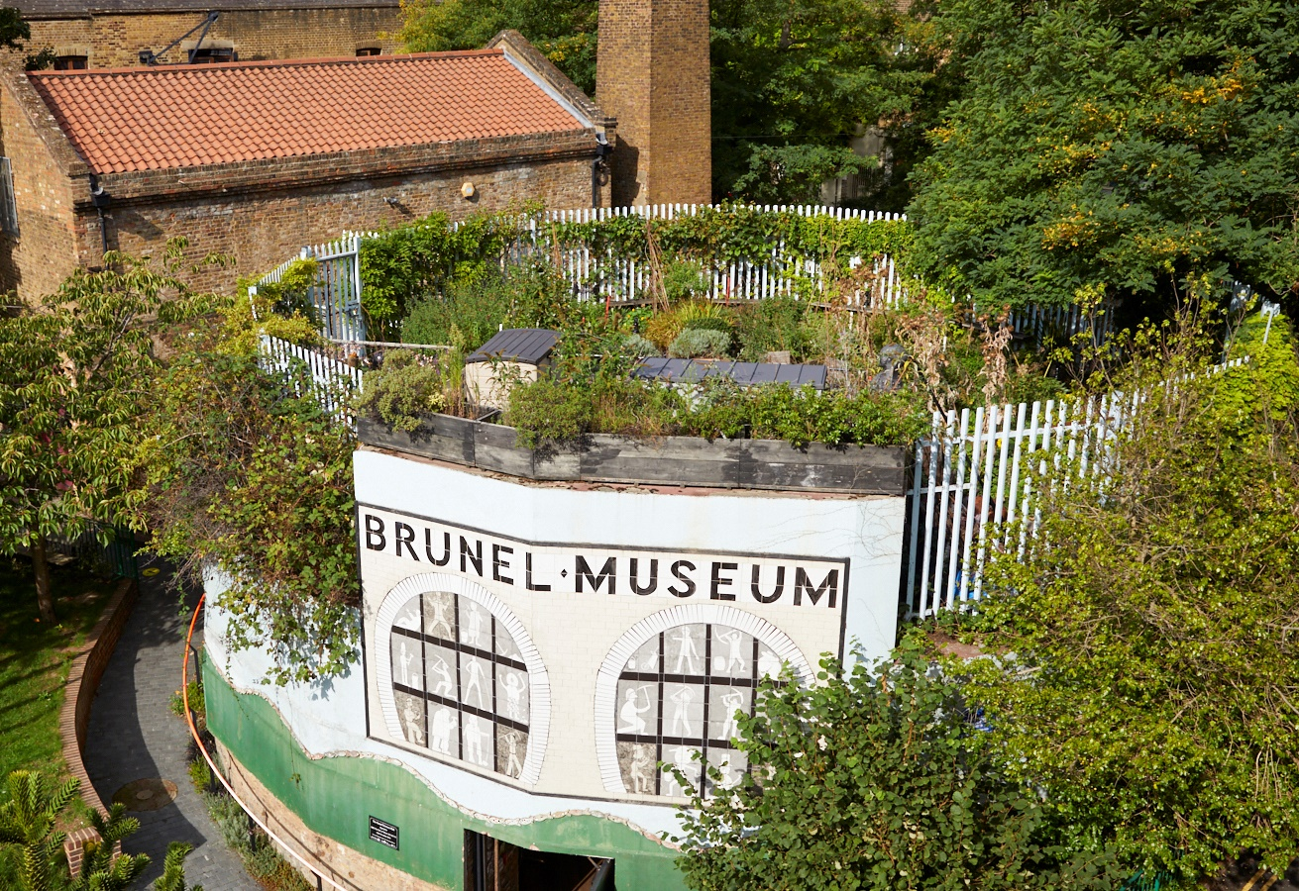
Brunel Museum
Events Assistant (Casual)
April 2026

Slide 2
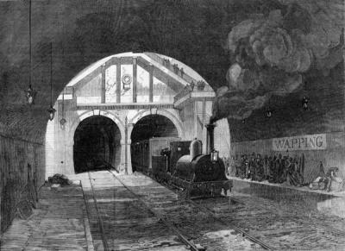
Contents
Welcome 3
About the Museum 4
About the Role 8
Application Process 14

Slide 3
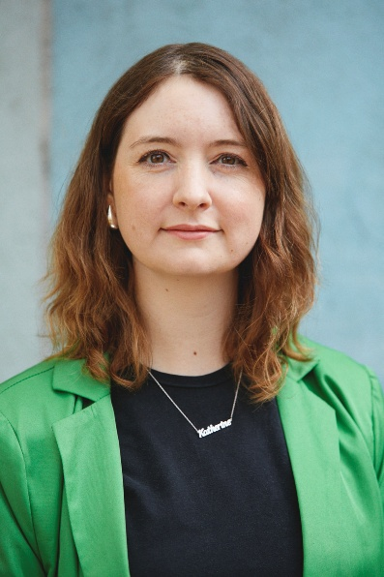
Welcome
Thank you for your interest in the Brunel Museum.
This role is an exciting opportunity to support our venue hire and museum-led events.
You’ll be a key part of a small and supportive team that works collaboratively to ensure the success of the organisation.
Please take a look at this pack which contains further information on the role, and the museum.
If you have further questions or would like to have a chat about the role, please just get in touch with us directly.
Katherine McAlpine
Director
Brunel Museum

Slide 4
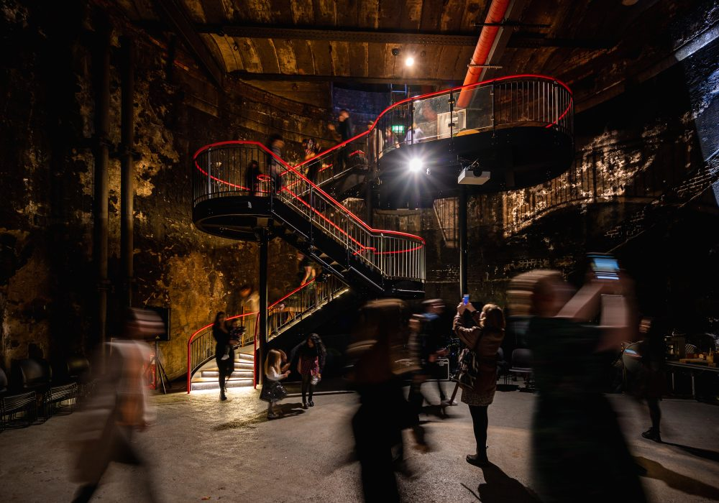
About the Museum
OUR MISSION
To preserve and share widely the ground-breaking stories of the Thames Tunnel project and the outstanding achievements of the Brunel family and their relevance to our lives today. We inspire communities through exploration, learning and performance.
WHAT WE DO
The Brunel Museum showcases the local story of the Brunel engineering family and how they changed the world. It is on the site of the world’s first tunnel under a navigable river, and was opened in 1843.
The tunnel was built using the newly invented tunnelling machine invented by Isambard Kingdom Brunel’s father, Marc Brunel. Today it is still in operation, as part of the London Overground railway network.
Located in Rotherhithe, the Museum is an educational charity. Trustees and staff are committed to widening community involvement with the Museum and to inspire people to explore, learn, share and enjoy our story of innovation and perseverance.

Slide 5
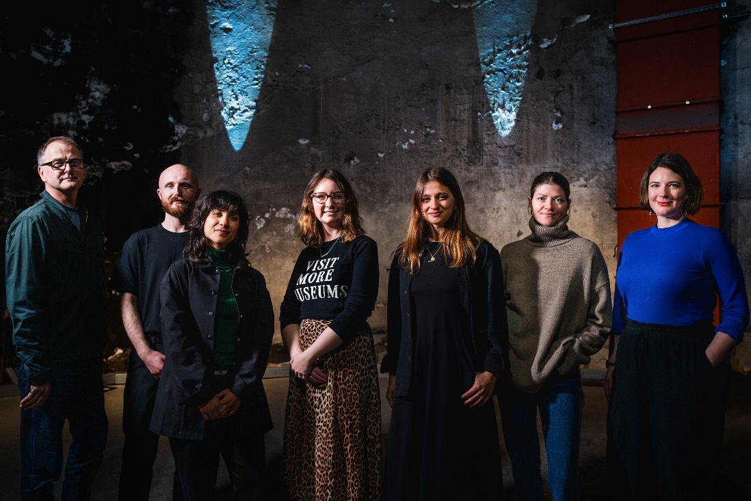
About the Museum
Museum Team
DIRECTOR
Brunel Museum Director, Katherine McAlpine, leads the team of dedicated staff and volunteers who help run the museum.
STAFF
Our small team of fantastic staff run the museum day-to-day activities.
VOLUNTEERS
Our volunteers are at the core of what we do here at the Brunel Museum. Our dedicated volunteer team serve as expert Thames Tunnel tour guides, manage the museum shop and facilities and help oversee school visits and museum events.
More information on the team and volunteers is here: https://thebrunelmuseum.com/about/

Slide 6
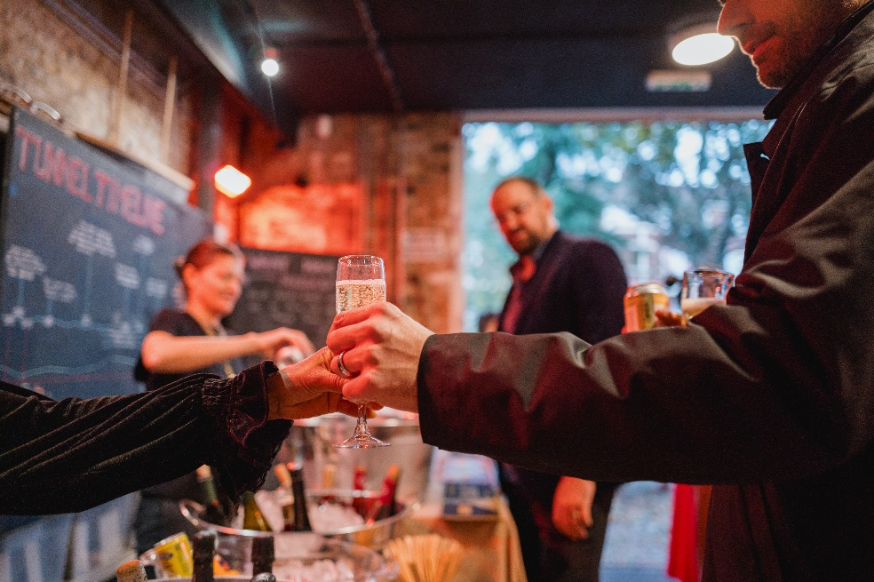
About the role
Practicalities
Reporting to: Events Producer
Hours of work: Casual, Minimum 4 hours per shift
Salary: £14.80 per hour (London Living Wage)
The Events Assistants will maintain the standards set by the Event Producer. The Events Assistant will have customer service at the forefront of everything they deliver and also carry a keen commercial and staff motivational ability. They will duty manage the site and bars.
This role will work alongside our Operations Coordinators, supporting event delivery through a range of tasks.
The working days and hours will be flexible across days, evenings and weekends, depending on the need of events, with Thursday evenings and Saturdays most popular days.
Please also note that we require a candidate who is available for our two major events taking place over the summer, on Saturday 11th July and Saturday 29th July. These are long event days and shifts can be up to 16 hours. They are full-day events starting in the morning and finishing late in the evening.

Slide 7
About the role
Responsibilities
Events Duty Manager
Serve as the first point of contact for the Museum via phone, email, social media, and in person.
Open and close the Museum following procedures.
Fill in end-of-day reports.
Supervise and support volunteers during opening hours.
Ensure the Museum spaces, including the shop area, are clean, well-stocked, and welcoming.
Conduct toilet checks every two hours and complete the toilet check form.
Take payments at the till and assist visitors with purchases.
Provide a warm welcome and the highest standard of customer service to all visitors.
Monitor building issues and visitor experience, reporting as needed.
Be available for Duty Manager shifts on Fridays, Saturdays, Sundays, and Mondays depending on Museum needs.
Process bookings for private tours and school groups

Slide 8
About the role
Responsibilities
Bar Operations
To ensure that all bars are stocked, merchandised, well presented
To close down service areas as required by the procedures and standards set out by the Event Producer ensuring areas are cleaned down and restocked on show days.
To continue to maximise the speed and standard of service at all bars, working on the bars to support as necessary.
Always ensure that all activity complies with relevant Health and Safety, food hygiene and licensing legislation and internal policies.
To provide accurate feedback to the Event producer on any trading related issues, such as trading patterns, staff performance, cash reconciliation and future possible opportunities. Report any losses of stock or cash, or health and safety incidents at a time appropriate to the circumstances.

Slide 9
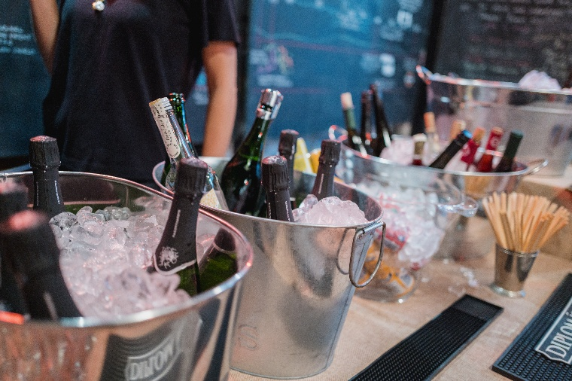
About the role
Skills & Qualifications
Previous bar experience essential.
Excellent customer service skills.
Confident working independently and managing public-facing situations.
Strong attention to detail.
Ability to work efficiently under pressure.
Good communication skills and ability to work well in a team.
Flexibility and adaptability, as you may be required to work various shifts till late night.
The job sometimes requires lifting heavy items and walking up and down stairs frequently, so you must be comfortable and physically able to do so.
Understanding of working in cultural or heritage environments.

Slide 10
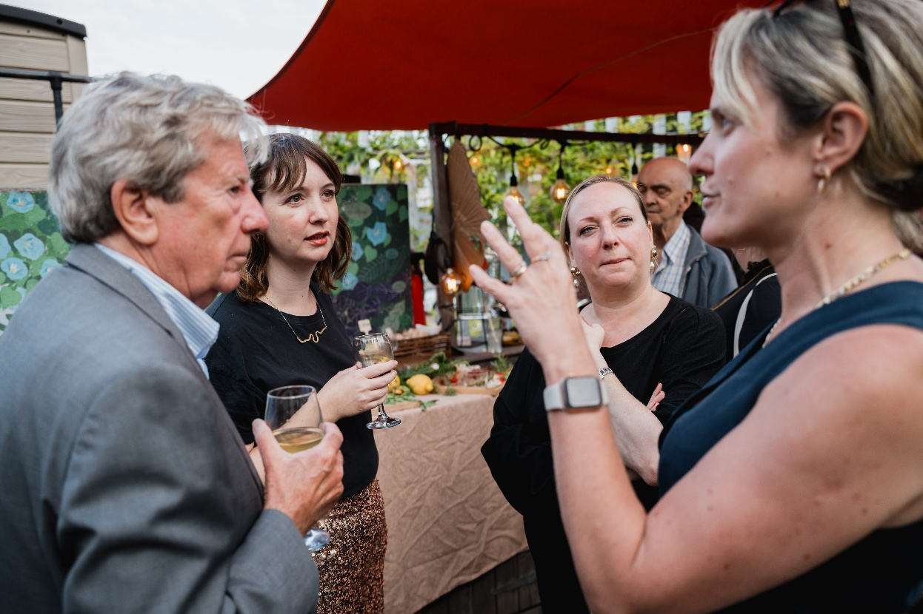
Application Process
HOW TO APPLY
Please apply by sending the following two documents to Alicja Sobczak
Alicja.Sobczak@thebrunelmuseum.com
a short (no more than one page) statement setting out why you are interested in the role
a CV (no more than two pages)
along with 2 references
Both documents should be in PDF or Word format.
The deadline for applications is <<< 9am Friday 15 Mays
TO FIND OUT MORE
If there is anything we can do to make the recruitment process more accessible and inclusive for you, if you would like support in communicating your skills, experience or enthusiasm, or if you would like to find out more about the role, please contact Alicja Sobczak
Alicja.Sobczak@thebrunelmuseum.com
INTERVIEWS
Interviews are expected to take place w/c 18 May

