Slide 1
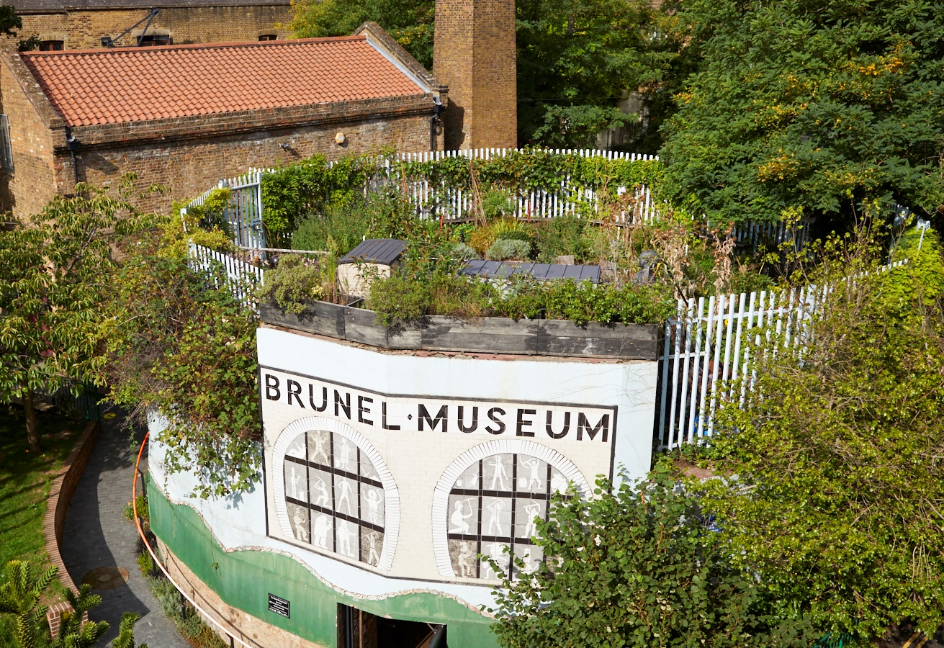
Brunel Museum
Cleaner
June 2026

Slide 2
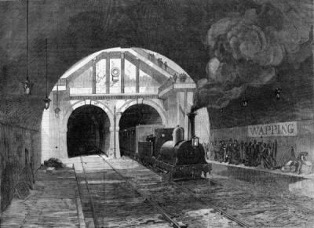
Contents
Welcome 3
About the Museum 4
About the Role 8
Application Process 14

Slide 3
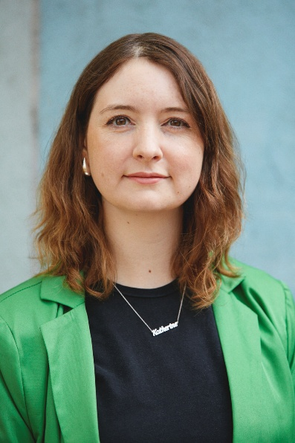
Welcome
Thank you for your interest in the Brunel Museum.
This role is an exciting opportunity to ensure the museum is a welcoming and clean space for all our visitors and guests.
You’ll be a key part of a small and supportive team that works collaboratively to ensure the success of the organisation.
Please take a look at this pack which contains further information on the role, and the museum.
If you have further questions or would like to have a chat about the role, please just get in touch with us directly.
Katherine McAlpine
Director
Brunel Museum

Slide 4
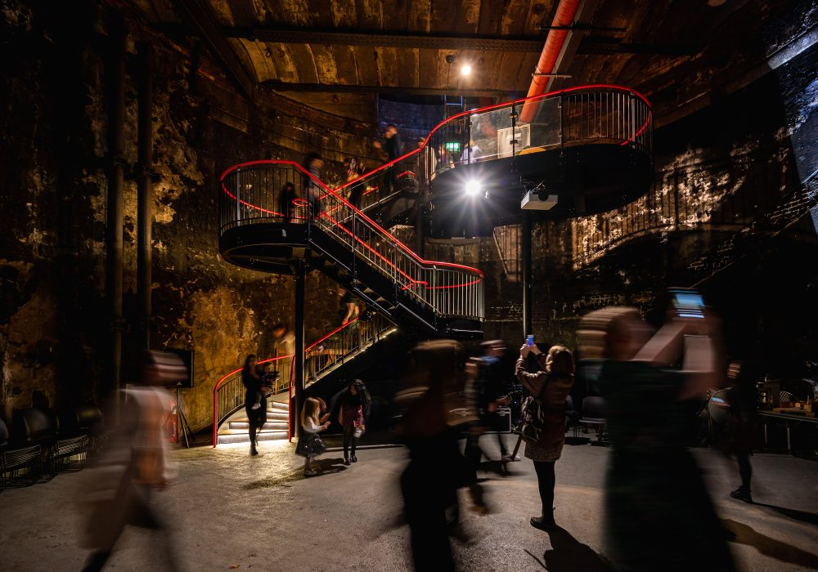
About the Museum
OUR MISSION
To preserve and share widely the ground-breaking stories of the Thames Tunnel project and the outstanding achievements of the Brunel family and their relevance to our lives today. We inspire communities through exploration, learning and performance.
WHAT WE DO
The Brunel Museum showcases the local story of the Brunel engineering family and how they changed the world. It is on the site of the world’s first tunnel under a navigable river, and was opened in 1843.
The tunnel was built using the newly invented tunnelling machine invented by Isambard Kingdom Brunel’s father, Marc Brunel. Today it is still in operation, as part of the London Overground railway network.
Located in Rotherhithe, the Museum is an educational charity. Trustees and staff are committed to widening community involvement with the Museum and to inspire people to explore, learn, share and enjoy our story of innovation and perseverance.

Slide 5
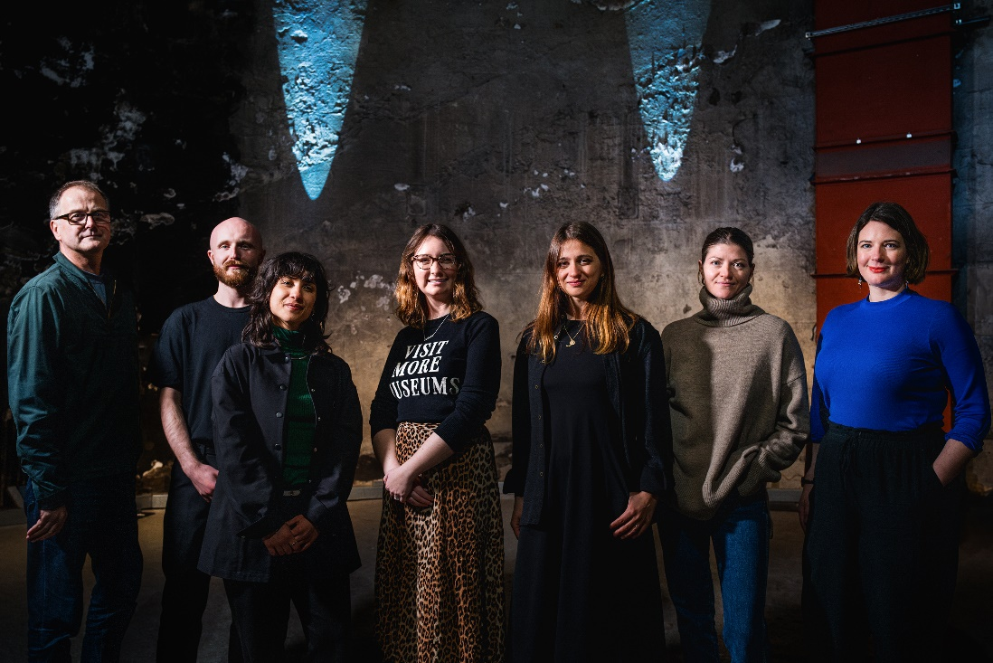
About the Museum
Museum Team
DIRECTOR
Brunel Museum Director, Katherine McAlpine, leads the team of dedicated staff and volunteers who help run the museum.
STAFF
Our small team of fantastic staff run the museum day-to-day activities.
VOLUNTEERS
Our volunteers are at the core of what we do here at the Brunel Museum. Our dedicated volunteer team serve as expert Thames Tunnel tour guides, manage the museum shop and facilities and help oversee school visits and museum events.
More information on the team and volunteers is here: https://thebrunelmuseum.com/about/

Slide 6
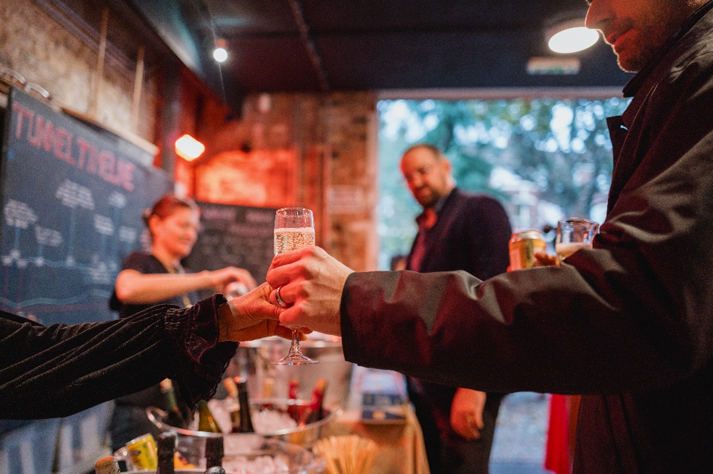
About the role
Practicalities
Reporting to: Events Producer
Hours of work: Minimum 6h a week; Plus event cleaning
Working Pattern: Friday, Saturday or Sunday, Monday – Before 10.30am (There is some flexibility)
Salary: £14.80 per hour (London Living Wage)
You will play a key role in ensuring the museum spaces are cleaned to a high standard, in line with Museum guidelines and regulations.
This is a contract role for 6 hours per week on a regular basis and additional shifts depending on the events schedule (approximately additional 3-5h a week). You will work mornings, flexible as long as the museum is cleaned by 10am over 3 days – Monday, Friday and either Saturday or Sunday.

Slide 7
About the role
Responsibilities
Perform general cleaning duties, including dusting, vacuuming, mopping, and sanitising surfaces
Clean and maintain restrooms, ensuring they are stocked with necessary supplies.
Empty bins and dispose of waste appropriately, and reporting any missed collections in a timely fashion
Maintain cleanliness in communal areas such as kitchens, break rooms, and meeting rooms, including washing up of mugs
Attend monthly Maintenance Walkarounds
Outside of monthly maintenance walkarounds, Log maintenance issues using the Museum's agreed reporting process.
Follow established cleaning protocols and adhere to health and safety regulations.
Work independently or as part of a team to complete cleaning tasks efficiently.

Slide 8
About the role
Responsibilities – Cont
Monitoring cleaning supplies, taking responsibility for ordering and restocking where appropriate, Report low stocks of toilet roll, hand towels, cleaning products and any other items to the Event Producer in a timely fashion
Take care with the outside of the building, removing any litter
Taking care of cleaning the rooftop bar pre events if required
Use Xero to complete timesheets in a timely fashion
Use relevant apps, for example tapo for lights in the shaft
Take care of own personal health and safety, including using Solo protect personal safety device
Attend a probation review and periodic supervision meetings as required
Duties may reasonably vary from time to time, provided they are broadly consistent with the nature and level of the role.

Slide 9
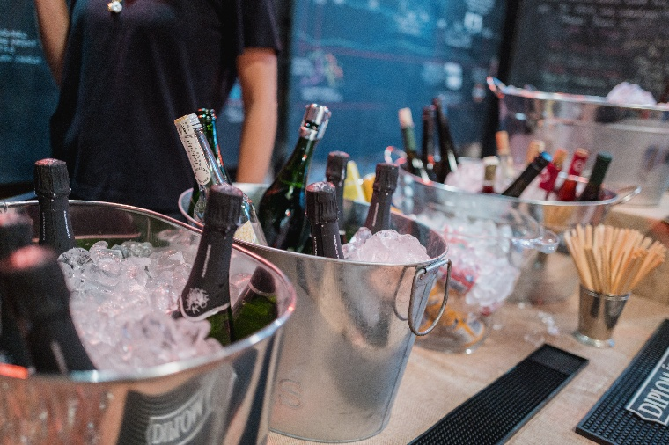
About the role
Skills & Qualifications
Essential:
Strong attention to detail with the ability to identify areas that require cleaning or maintenance.
Excellent time management skills to ensure all tasks are completed within designated timeframes.
Good communication skills for reporting issues or collaborating with team members.
Ability to work independently with minimal supervision while being reliable and trustworthy.
Knowledge of natural cleaning products and their safe usage is beneficial.
Confidence lone working and ability to take responsibility for personal health and safety
Evening and weekend availability
IT literate including ability to use apps to log timesheets, etc, or willingness to learn
Desirable:
Previous experience in a cleaning role is advantageous but not essential; training will be provided.
Access to a washing machine would be desirable

Slide 10
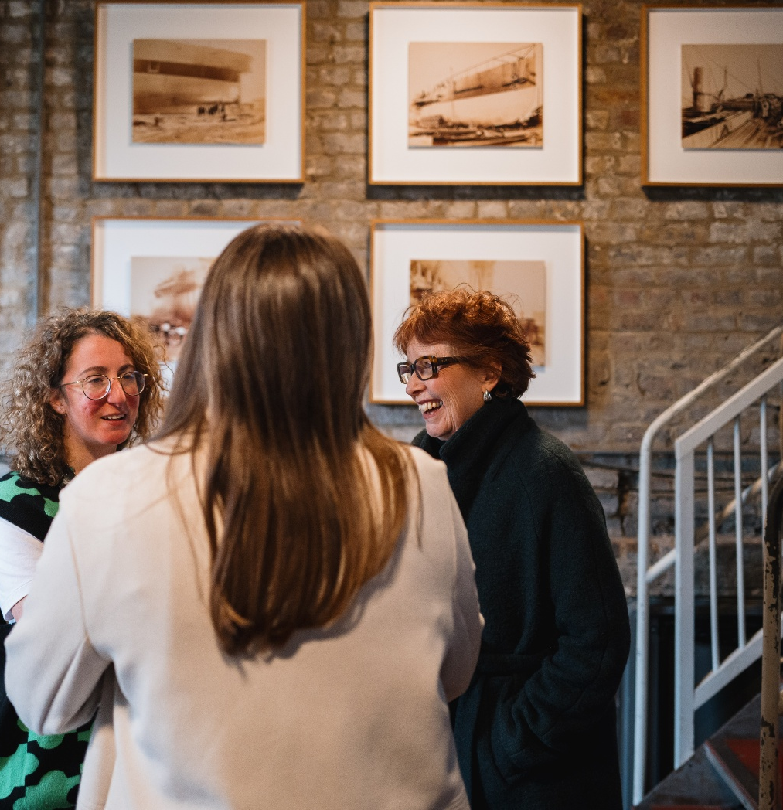
Benefits
In addition to 28 days holiday (pro rata for part-time), each employee is entitled to up to 2 additional days per year as Climate Perks Days.
A seasonal flu voucher scheme
Access to a confidential employee assistance programme
The Museum appreciates flexibility from its staff, and endeavours to do the same. If you require flexibility in this role, please do not hesitate to get in touch.

Slide 11
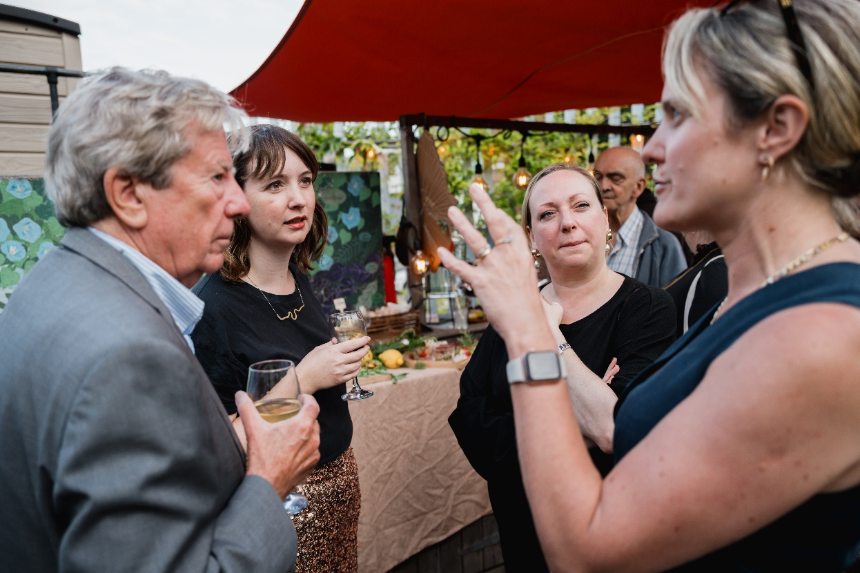
Application Process
HOW TO APPLY
Please apply by sending the following two documents to Alicja Sobczak
Alicja.Sobczak@thebrunelmuseum.com
a short (no more than one page) statement setting out why you are interested in the role
a CV (no more than two pages)
along with 2 references
Both documents should be in PDF or Word format.
The deadline for applications is <<< 9am Wednesday 8 July
TO FIND OUT MORE
If there is anything we can do to make the recruitment process more accessible and inclusive for you, if you would like support in communicating your skills, experience or enthusiasm, or if you would like to find out more about the role, please contact Alicja Sobczak
Alicja.Sobczak@thebrunelmuseum.com
INTERVIEWS
Interviews are expected to take place w/c 20 July

