Slide 1
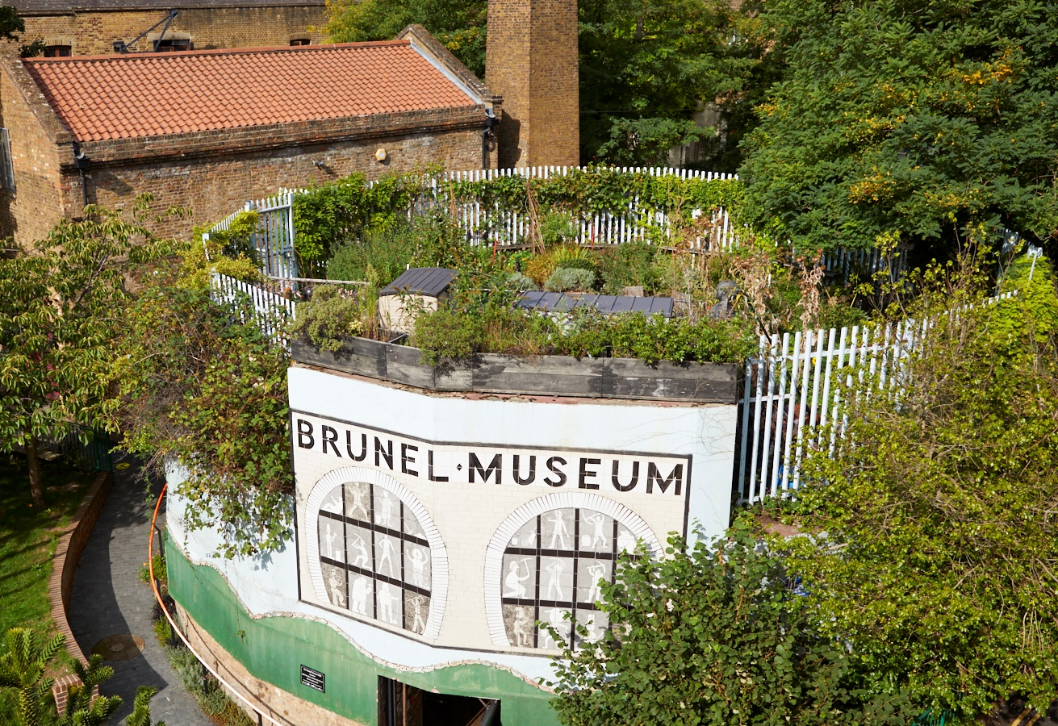
Brunel Museum
General Manager
October 2026

Slide 2
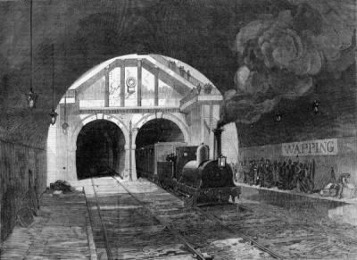
Contents
Welcome 3
About the Museum 4
About the Role 8
Application Process 14

Slide 3
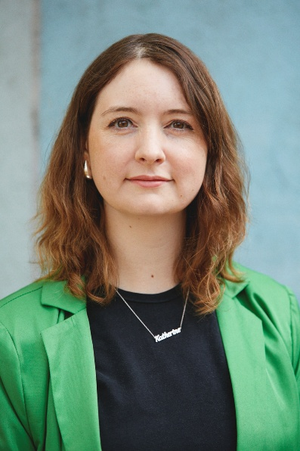
Welcome
Thank you for your interest in the Brunel Museum.
This role is an exciting opportunity to ensure the museum is a welcoming environment for visitors.
You’ll be a key part of a small and supportive team that works collaboratively to ensure the success of the organisation.
Please take a look at this pack which contains further information on the role, and the museum.
If you have further questions or would like to have a chat about the role, please just get in touch with us directly.
Katherine McAlpine
Director
Brunel Museum

Slide 4
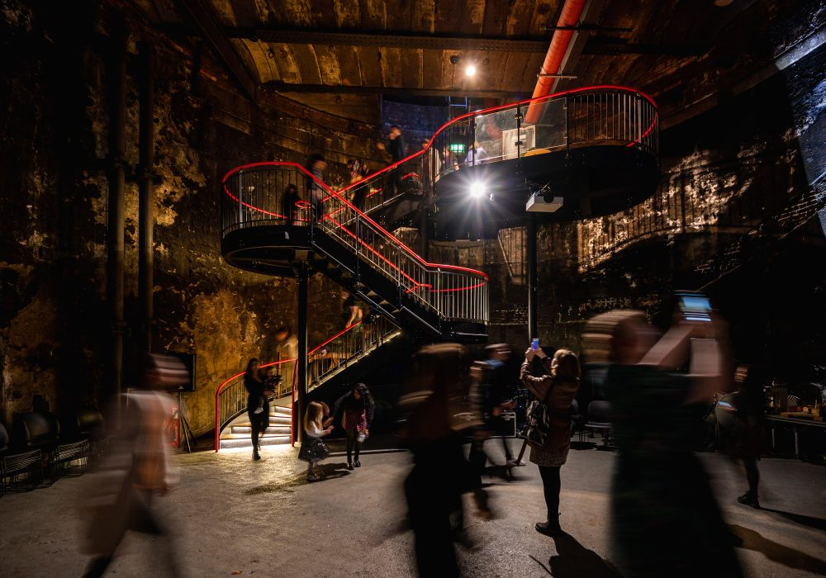
About the Museum
OUR MISSION
To preserve and share widely the ground-breaking stories of the Thames Tunnel project and the outstanding achievements of the Brunel family and their relevance to our lives today. We inspire communities through exploration, learning and performance.
WHAT WE DO
The Brunel Museum showcases the local story of the Brunel engineering family and how they changed the world. It is on the site of the world’s first tunnel under a navigable river, and was opened in 1843.
The tunnel was built using the newly invented tunnelling machine invented by Isambard Kingdom Brunel’s father, Marc Brunel. Today it is still in operation, as part of the London Overground railway network.
Located in Rotherhithe, the Museum is an educational charity. Trustees and staff are committed to widening community involvement with the Museum and to inspire people to explore, learn, share and enjoy our story of innovation and perseverance.

Slide 5
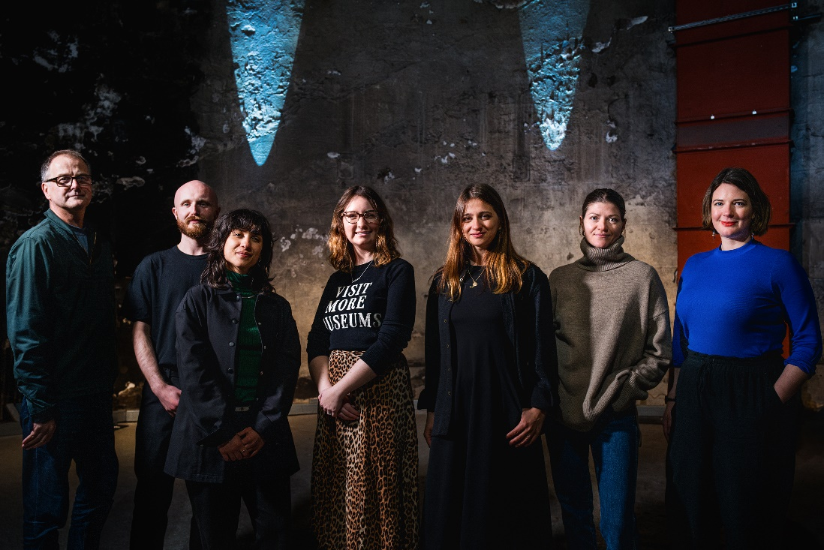
About the Museum
Museum Team
DIRECTOR
Brunel Museum Director, Katherine McAlpine, leads the team of dedicated staff and volunteers who help run the museum.
STAFF
Our small team of fantastic staff run the museum day-to-day activities.
VOLUNTEERS
Our volunteers are at the core of what we do here at the Brunel Museum. Our dedicated volunteer team serve as expert Thames Tunnel tour guides, manage the museum shop and facilities and help oversee school visits and museum events.
More information on the team and volunteers is here: https://thebrunelmuseum.com/about/

Slide 6
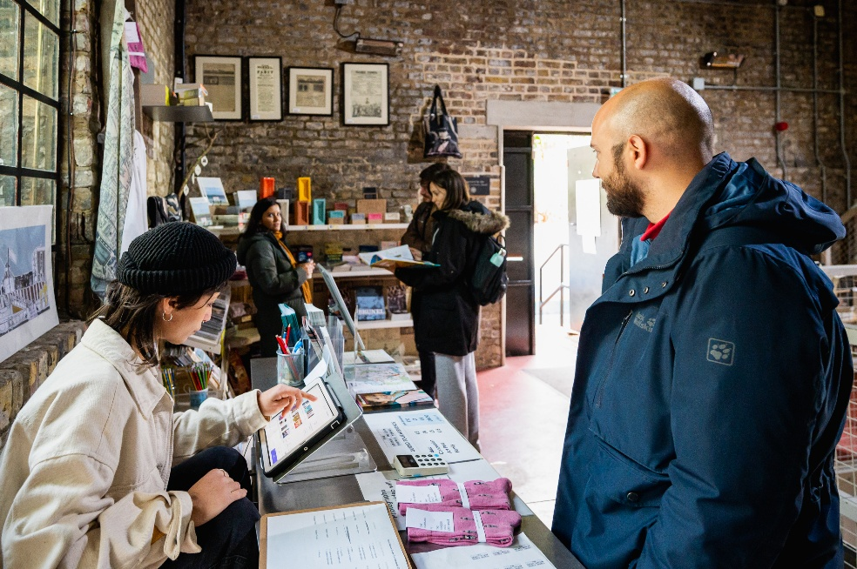
About the role
Practicalities
Reporting to: Director
Hours of work: Full-time (0.8 will be considered for an exceptional candidate)
Salary: £37, 000
The General Manager plays a key role in ensuring the smooth day-to-day operation of the Brunel Museum.
The postholder will act as Duty Manager during public opening hours, coordinate visitor services, support income generation through memberships, donations and retail sales, and oversee the practical operation of the Museum site.
The role combines visitor experience, operational delivery, facilities administration and supporter engagement, helping to ensure the Museum remains welcoming, safe and financially sustainable.
This role would suit an ambitious, hands on generalist, who is equally interested in both people and process.

Slide 7
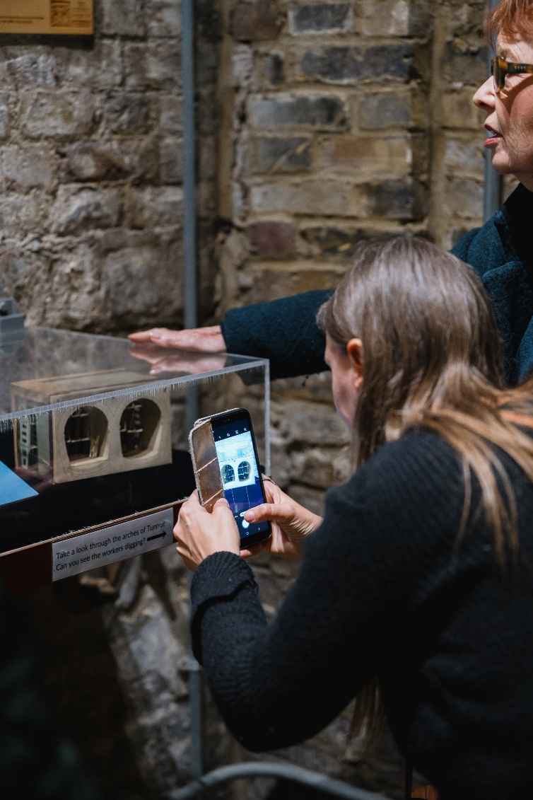
About the role
Responsibilities
Museum Operations and Retail
Act as Organisational lead for all visitor experience and museum operations, including weekly opening, private tours and school visits
Act as Duty Manager 2 days per week (Monday and Friday), ensuring all opening up and closing down procedures are followed, and volunteers are briefed appropriately
Circulate end of week reports, flagging any operational issues
Be the onsite lead for any health and safety and safeguarding issues
Be the site security and safety operational lead, leading on all compliance including the annual compliance calendar (for example annual PAT testing, annual security reviews), ensuring relevant information is cascaded across the staff and volunteers, escalating to the Director and Board as appropriate

Slide 8
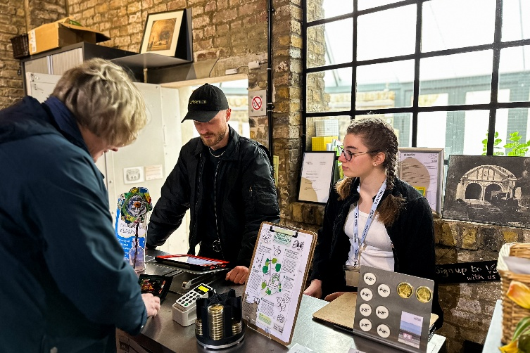
About the role
Responsibilities
Museum Operations and Retail cont.
Manage and maintain all operational policies and procedures (Lost Property…etc)
Act as the first point of escalation for routine operational matters, escalating to the Director when necessary
Take an effective and pragmatic approach to risk management, including taking responsibility for the Organisational compliance calendar, risk register, accident reporting and fire safety monitoring
Lead the Museum’s retail function, including oversee quarterly purchasing for retail and merchandising calendar, producing quarterly reports on sales, and suggest new product lines

Slide 9
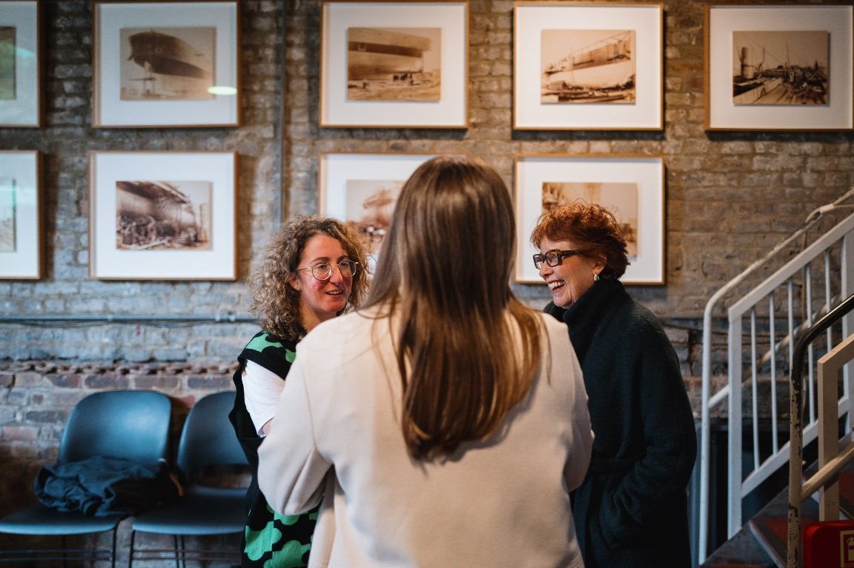
About the role
Responsibilities – Cont
Team Leadership
Train and lead Volunteer team, along with Learning Producer, to deliver excellent visitor experience, and achieve targets for donations, Gift Aid and Membership
Work with the Learning & Audience Producer to maintain an annual training calendar for casual staff and volunteers (including but not limited to fire Safety, First Aid, Safeguarding, How to use the till)
Manage the Museum’s cleaner, ensuring the museum is presentable to all visitors and guests
Manage the Finance Coordinator, ensuring all finance processes are properly followed

Slide 10
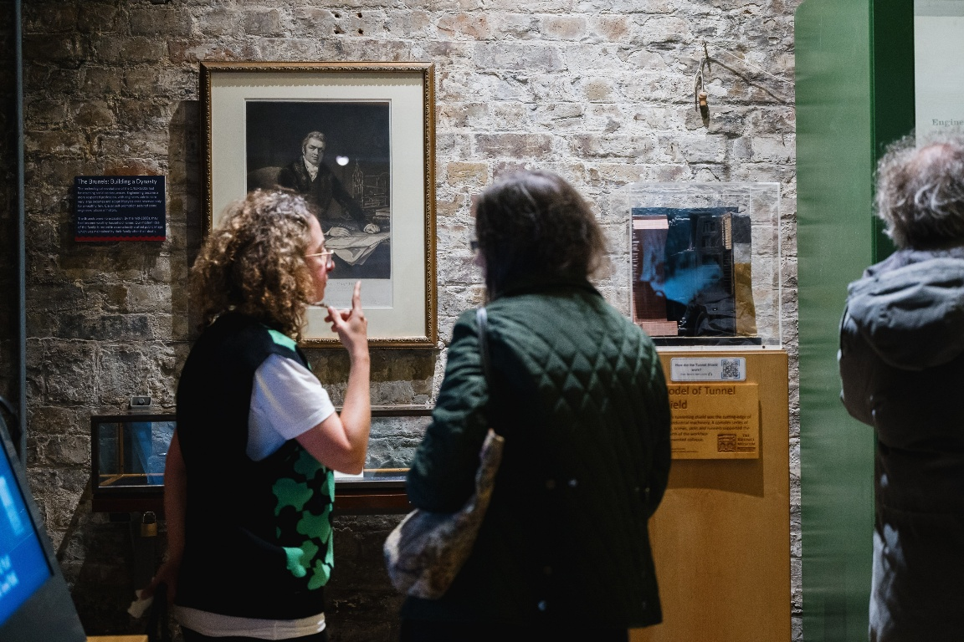
About the role
Responsibilities – Cont
Team Leadership Contd.
Manage the weekend Duty Managers and the casual Duty Managers, including holiday and sickness cover, including following the museum’s processes around Probation, annual appraisals, Return-to-work meetings etc
Working with the Event Producer to rostering casual staff for venue hire events including pre and post event cleaning
Balance operational needs with efficiencies when rostering
Maintain oversight of staff holiday, rostering casual staff when needed for cover
Support Finance Manager with monthly payroll

Slide 11
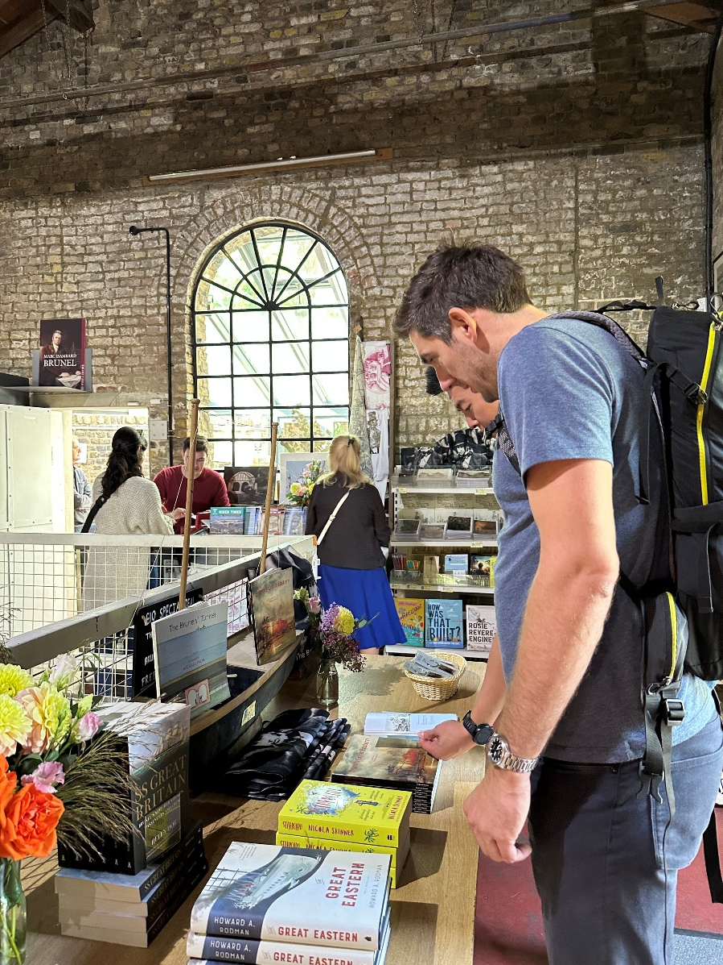
About the role
Responsibilities – Cont
HR and People management
Leading on recruitment of new casual staff when required, including drafting adverts, Coordinating recruitment and onboarding
Manage the annual staff and volunteer survey process, ensuring that insights are used to improve the staff experience
Working with the Director and the Remuneration and people committee to create and maintain Policy review schedule, updating policies and the Staff handbook where required

Slide 12
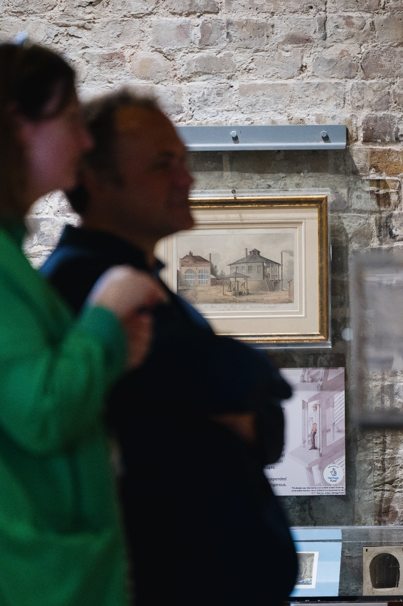
About the role
Responsibilities – Cont
Budget and Financial management
Oversee operational budgets, identifying opportunities for efficiencies and costs savings
Manage relationships with key suppliers, such as Insurance providers, IT & Telephone, Energy
Work closely with the Director and Finance Manager on budget monitoring
Monthly reporting on key areas, highlighting areas for improvement
  Admissions
  Shop
  Memberships
  Donations
  Venue hire
  School visits

Slide 13
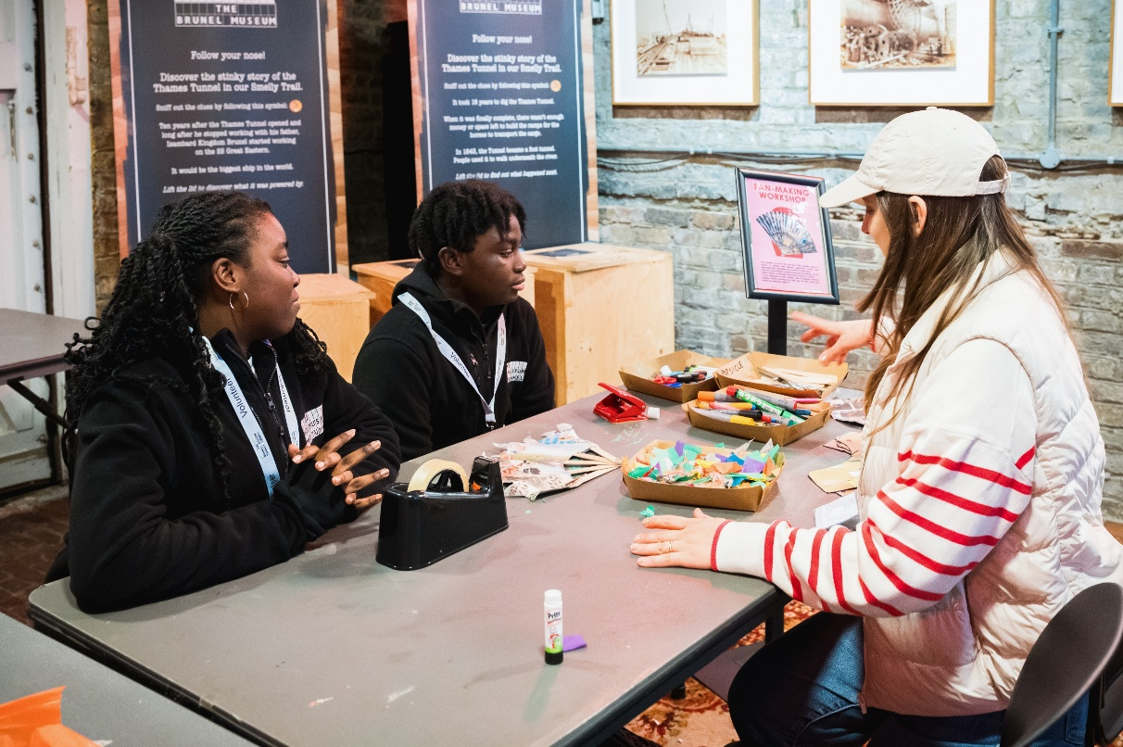
About the role
Responsibilities – Cont
General
Attend staff meetings and training as required.
Follow Museum policies and procedures.
Comply with health and safety requirements.
Undertake other duties reasonably requested by senior staff.

Slide 14
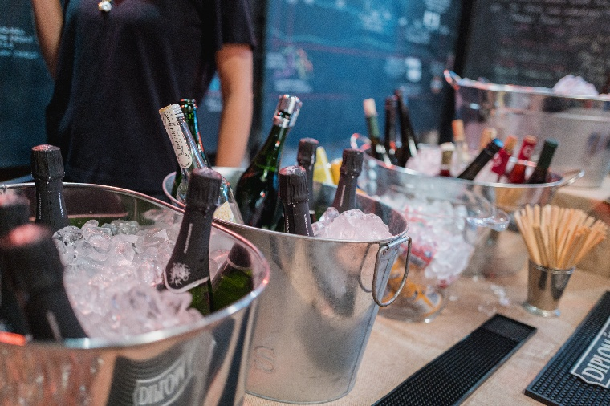
About the role
Skills & Qualifications
Operational leadership:
People leadership:
Organisation and project management:
Health, safety, safeguarding and risk:
Financial and commercial awareness:
Communication and collaboration:
Judgement and leadership:
Desirable:
A financial qualification (or equivalent experience)
First Aid qualification
Awareness of Health and Safety including Fire safety

Slide 15
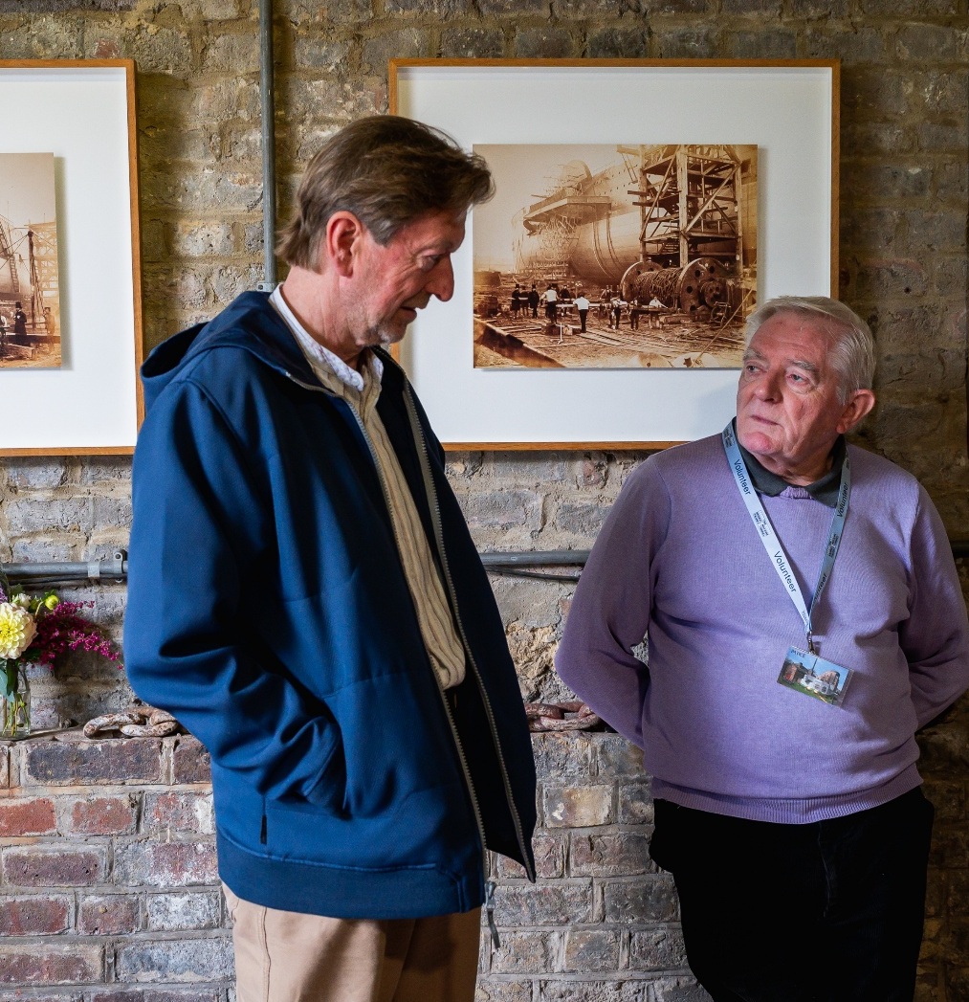
Benefits
In addition to 28 days holiday (pro rata for part-time), each employee is entitled to up to 2 additional days per year as Climate Perks Days.
A seasonal flu voucher scheme
Access to a confidential employee assistance programme
The Museum appreciates flexibility from its staff, and endeavours to do the same. If you require flexibility in this role, please do not hesitate to get in touch.

Slide 16
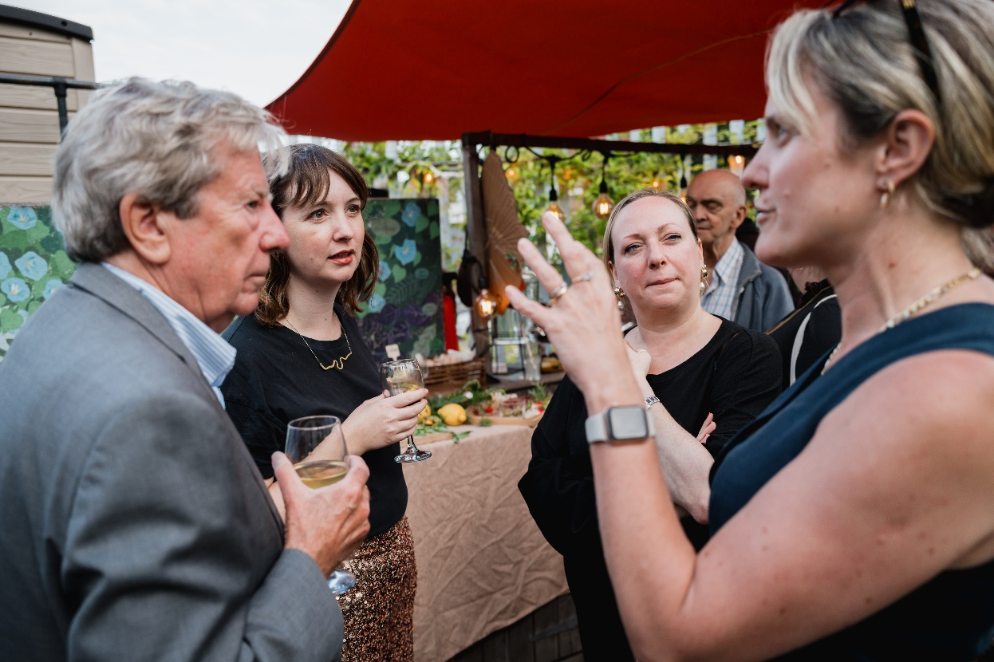
Application Process
HOW TO APPLY
Please apply by sending the following two documents to Katherine McAlpine katherine.mcalpine@thebrunelmuseum.com a short (no more than one page) statement setting out why you are interested in the role
a CV (no more than two pages)
along with 2 references
Both documents should be in PDF or Word format.
The deadline for applications is <<< 9am Monday 23 November
TO FIND OUT MORE
If there is anything we can do to make the recruitment process more accessible and inclusive for you, if you would like support in communicating your skills, experience or enthusiasm, or if you would like to find out more about the role, please contact
INTERVIEWS
Interviews are expected to take place w/c 7 December

